Slide 1
WELCOME

Slide 2

AN ANALYSIS OF ELECTRIC VEHICLES
Presented By:
Angel Jacob
Data Analytics 2025

Slide 3
“ In order to have clean air in cities ,you have to go electric.”
-Elon Musk

Slide 4
Abstract
Electric vehicles (EVs) are cars that run on electricity instead of gasoline or diesel. They use batteries to store power and produce no harmful emissions and helping reduce air pollution.

Slide 5
Introduction
Electric Vehicles are on the rise .
In 2021 ,there were over 10 millions EVs on the road globally ,and this number is expected to continue to grow in the coming years.
There are 2 types of EV’s ,the Battery Electric Vehicles(BEVs), and Plug-in Hybrid Electric Vehicles(PHEVs) that are currently registered through Washington State Department of Licensing(DOL) ranging from 2011 till mid of 2024.

Slide 6
Objectives
To trends in EV adoption over different years.
To analyse the distribution of EV types(BEV,PHEV).
To identify state-wise distribution and trends in EV adoption.
Investigate the proportion of vehicles eligible for Clean Alternative Fuel Vehicle(CAFV)

Slide 7
Datasets
Source of dataset : Kaggle
Number of columns : 17
Number of rows : 10000+
Time period : 2011 - 2024

Slide 8
Visualization
Purpose
For creating interactive and insightful dashboards
Key visuals
Cards :To shows the total vehicles and average electric range.
Line-area chart : To identify the total vehicle based on model year(from 2011-2024)
Lollipop chart: To identify the top 10 companies based on total vehicles.
Donut chart : To understand total vehicle by Clean Alternative Fuel Vehicle Eligibility (CAFV).
Map : To find the total vehicle by state.
Bubble chart : To identify the Electric vehicle type by total vehicles.
Parameters : To shows the top 10 companies.

Slide 9
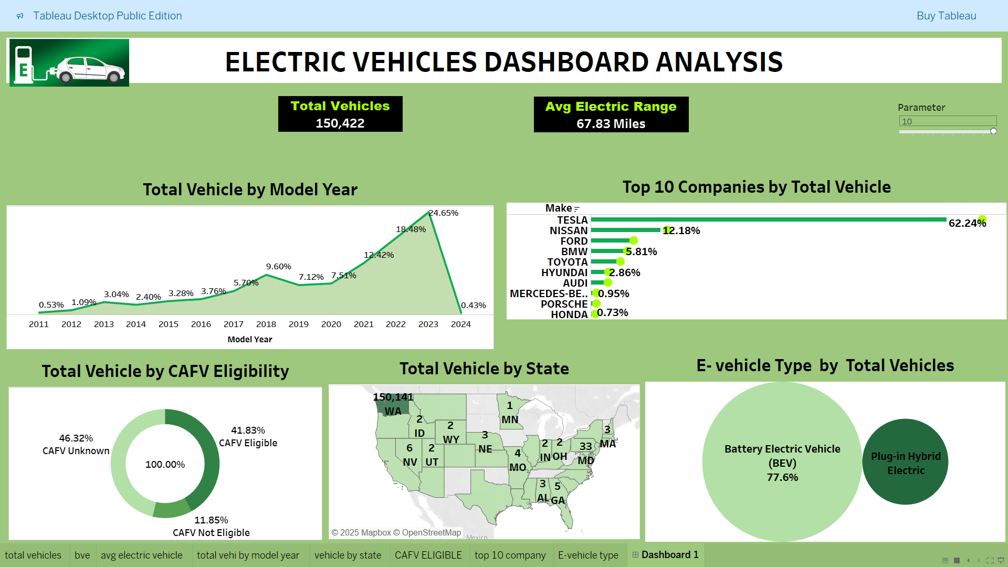

Slide 10
Insights
Each year, the sales of EV have been steadily increasing and Highest production in 2023
Tesla is leading the market with 62.24% share of EVs
The state of Washington is at the forefront of EV adoption.
Among all the vehicles 41.83% are CAFV approved
Battery Electric Vehicles(BEVs) are the dominant type than PHEVs.

Slide 11
Recommendations
Expanding public access to EV charging station
Target high demanded areas
Commit to long term investment in R&D.

Slide 12
Conclusion
The transition of electric vehicles is not just a fleeting trend;
It represents a fundamental shift towards sustainable transportation.
Our analysis provides valuable insights into the growth, efficiency and adoption patterns of electric vehicles to make data –driven decisions.

Slide 13
THANK YOU

